Slide 1
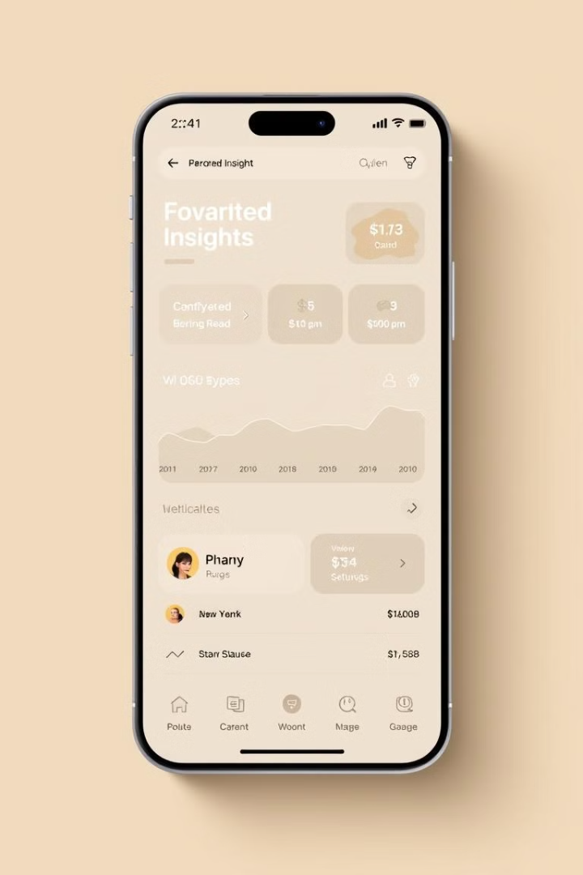
SmartFin: Creating an MVP for Personalized Financial Management Solutions
This presentation outlines the development of SmartFin, an AI-powered financial management solution designed to empower students, young professionals, and tech-savvy individuals with personalized financial insights and guidance.

Slide 2
The MVP Approach
Core Principles
Key Strategies
SmartFin’s MVP prioritizes minimal investment, focusing on essential features to validate user needs and minimize wasted resources. This approach ensures that the product evolves in line with market demands.
We utilize low-cost, high-impact marketing strategies like social media, influencer collaborations, and pre-sales campaigns to gauge user interest and gather valuable feedback.

Slide 3

Addressing the Problem
Financial Literacy Gap
SmartFin's Solution
Many individuals, especially students and young professionals, lack the financial literacy and tools to effectively manage their finances, leading to poor money habits and missed opportunities.
SmartFin leverages AI to simplify financial management, providing real-time expense categorization, tailored budget recommendations, and ongoing monitoring of spending habits.

Slide 4




Target Audience
Students
Young Professionals
Tech-Savvy Users
Students often have limited budgets and need to manage academic expenses, student loans, and part-time income.
Young professionals face new responsibilities like rent, bills, and saving for larger goals, requiring a convenient digital solution.
Tech-savvy users expect personalization, data-driven insights, and a well-designed user interface for their financial tools.

Slide 5
Competitor Analysis
App
Strengths
Weaknesses
Mint
Broad financial tracking capabilities, brand familiarity
Lack of nuanced personalization
YNAB
Goal-driven budgeting methodology
Steep learning curve
PocketGuard
User-friendly interface, visually appealing
Could benefit from deeper analytics and predictive modeling

Slide 6
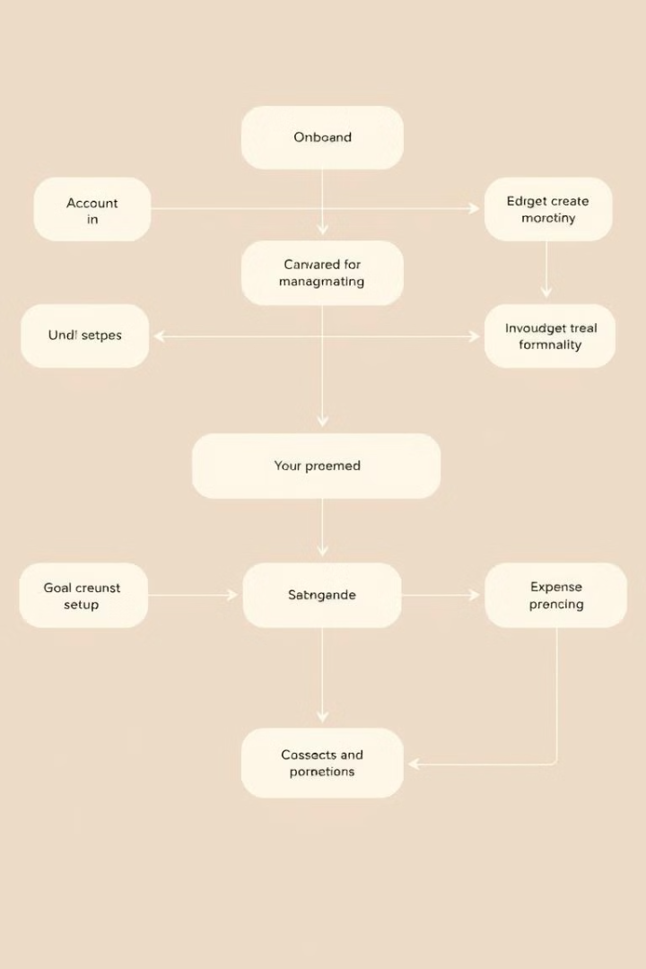
User Path Map
1
Onboarding
Users provide financial goals, spending habits, and account information for personalized recommendations.
2
Budget Setup
AI-driven budget suggestions based on user data and linked accounts, with automatic expense categorization.
3
Goal Management
Users set financial goals, receive progress updates, and get personalized advice on achieving their objectives.

Slide 7









MVP Features and Priorities
1
Core Features
2
AI-Driven Budget Creation
3
Real-Time Expense Categorization
4
Personalized Financial Insights
5
Secondary Features
6
Gamification of Savings Goals
7
Direct Integration with Banking Systems
8
Lower Priority Features
9
Multi-Currency Tracking
10
Advanced Analytics Dashboards

Slide 8

Key Takeaways and Next Steps
SmartFin’s MVP development process has validated the need for personalized financial management solutions, particularly for students and young professionals. The focus on minimal investment, user-centered validation, and continuous iteration has proven effective in shaping the product’s direction.
The next steps involve refining the MVP based on user feedback, expanding core functionalities, and exploring new integrations. By adhering to lean startup methodologies, SmartFin aims to become a valuable and robust financial management tool for its target audience.

Slide 9

Interim Findings and Conclusion
The SmartFin MVP development has been a success so far. The user feedback has been positive and has helped to shape the product's direction.
The team has validated the need for personalized financial management solutions, particularly for students and young professionals.
The next steps involve refining the MVP based on user feedback, expanding core functionalities, and exploring new integrations.

Slide 10

Interim Findings and Conclusion
SmartFin's MVP development process has yielded significant insights and positive results. The user feedback collected has been valuable in shaping the product's direction and validating its core functionalities.
1
User Validation
2
Product Roadmap
The MVP has successfully validated the need for personalized financial management solutions, particularly for students and young professionals.
The next steps involve refining the MVP based on user feedback, expanding core functionalities, and exploring new integrations.

Slide 11
References
Allied Market Research. (n.d.). Personal Finance Software Market Size. Retrieved from https://www.alliedmarketresearch.com.
Blank, S. (2013). The Four Steps to the Epiphany: Successful Strategies for Products That Win. K & S Ranch Press.
Ries, E. (2011). The Lean Startup: How Today’s Entrepreneurs Use Continuous Innovation to Create Radically Successful Businesses. Crown Business.
Hoffmann, A. O. I., & Risse, L. (2019). Do good things come in pairs? SSRN Electronic Journal. https://doi.org/10.2139/ssrn.3367924.
VC.ru (n.d.). Customer Development in Business: Instructions and Examples. https://vc.ru/marketing.

